Slide 1

Meeting the needs of learners with SEND within a knowledge rich curriculum
Gary Aubin
@SENDMattersUK
SEND Content Specialist
Education Endowment Foundation
MAT SEND Lead
Author, The Lone SENDCO
East Midland South Challenge Partners Hub
27th June 2022

Slide 2
EEF Mission
The Education Endowment Foundation (EEF) is dedicated to breaking the link between family income and educational achievement.

Slide 3
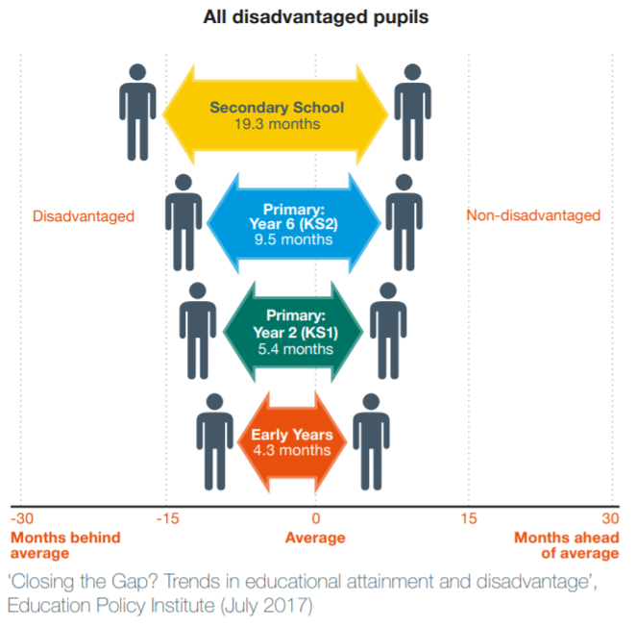
Why we do it
Notes:
There is a consistent gap in children and young people’s attainment linked to economic disadvantage.
The attainment gap is largest for children and young people eligible for free school meals (the best available proxy measure of economic disadvantage) and those assessed with special educational needs.
The gap exists in all types of schools The attainment gap is not a problem restricted only to schools classified as under-performing: it is found in all types of schools.
• The gap begins in the early years and is already evident when children begin school aged 5.
• The gap grows wider at every following stage of education: it more than doubles to 9.5 months by the end of primary school, and then more than doubles again, to 19.3 months, by the end of secondary school. This shows the importance of intervening early and then of continuing to attend to the needs of disadvantaged pupils.

Slide 4
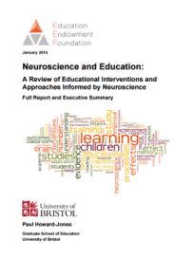

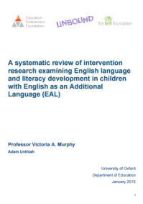
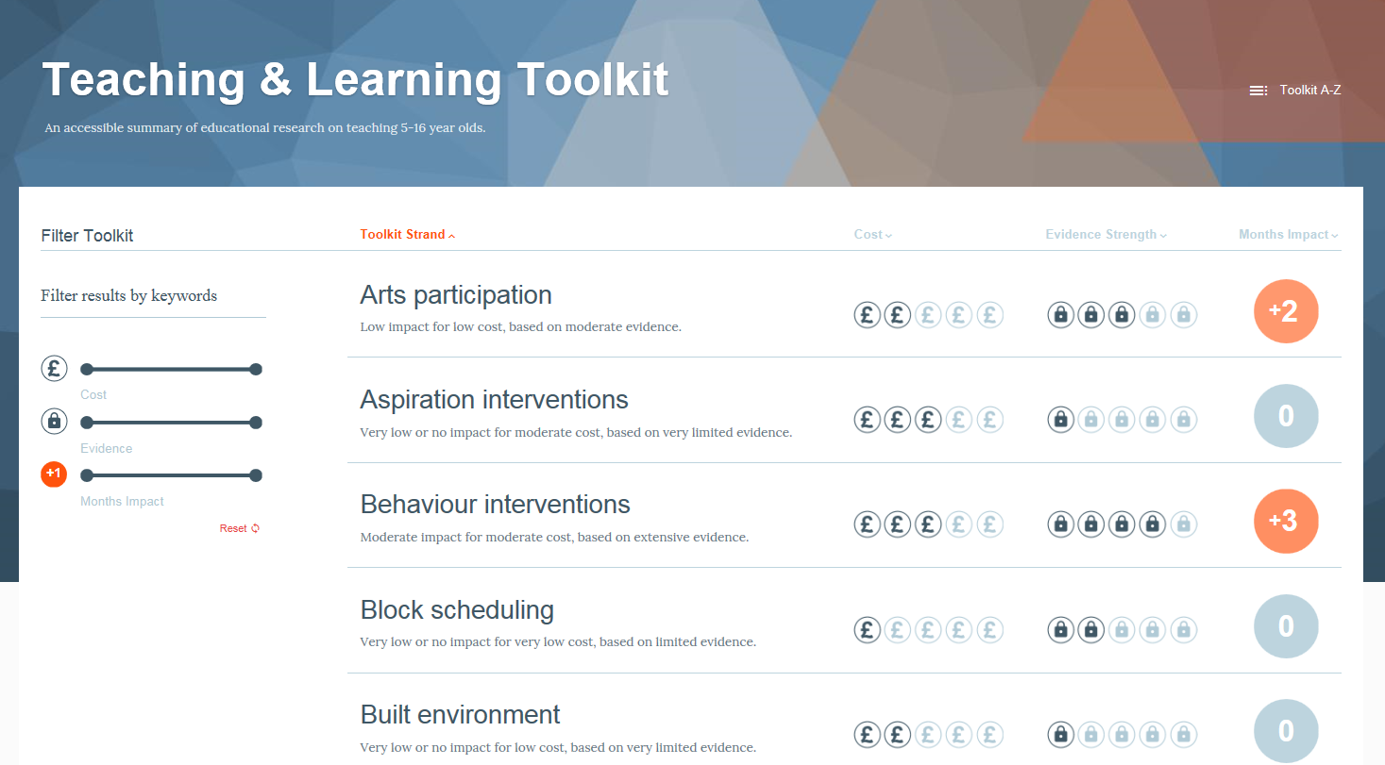
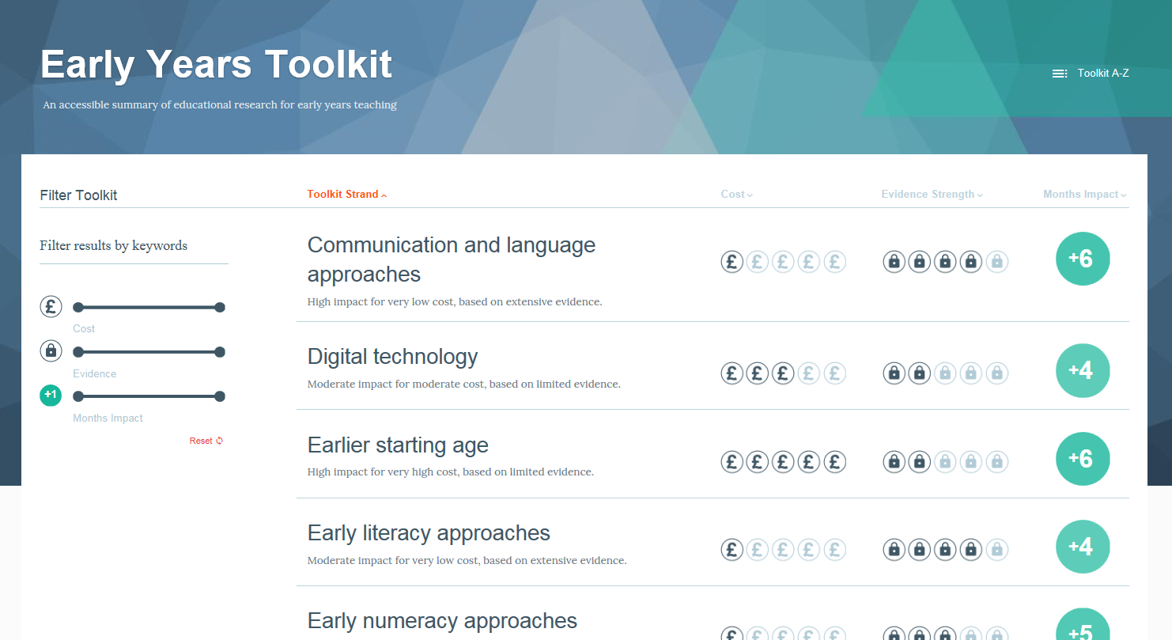

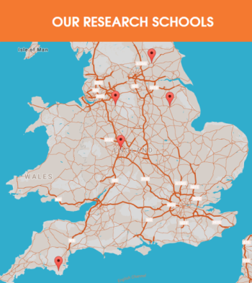
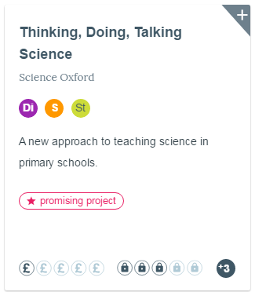


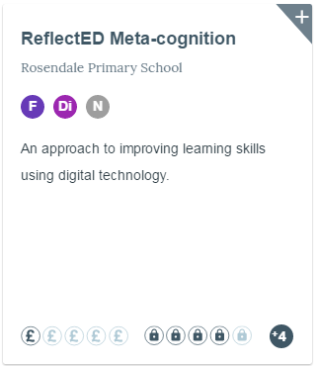
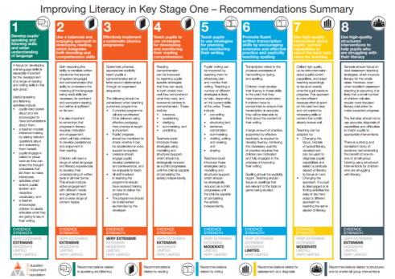
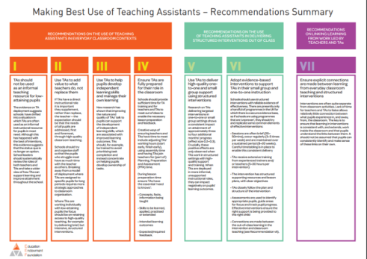
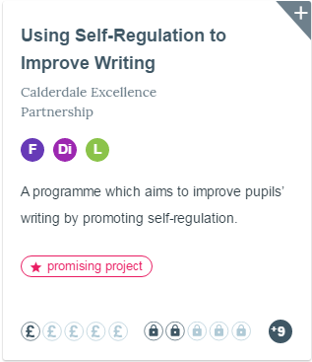
children and young people reached
Synthesis
1,300,000
13,000+
Generation
Mobilisation
schools, nurseries, colleges involved
Notes:
How we achieve our mission
We summarise the best available evidence for teachers and senior leaders. Our Teaching and Learning Toolkit is now used by 70% of secondary schools.
We generate new evidence of ‘what works’ to improve teaching and learning, funding independent evaluations of high-potential projects. We’ve tested over 190 high-potential programmes with over 1.3 million children and young people and our most promising programmes have enabled students to make +3 months of additional progress in a year.
We support teachers and senior leaders across the country to use this evidence to achieve the maximum possible benefit for young people. We work in partnership with a network of Research Schools across the country.

Slide 5
Using evidence
Evidence Informed Practice
Professional
Expertise
Evidence
Evidence provides 'best bets' to help teachers and leaders to make more informed decisions about what to do (and what to stop doing).
Research evidence supplements expertise, it does not supplant it.
Notes:
Evidence should be used alongside and combined with professional expertise.
The evidence gives best bets, it doesn’t till you exactly what to do in every context, for every decision, with every child, rather it can help professional make more informed decisions.
Research evidence tells you what worked in the past on average – so you have to be aware of how it can be applied and implemented in your particular context.

Slide 6

An introduction to the guidance report

Slide 7


The guidance report process
children and young people reached
1,300,000
schools, nurseries, colleges involved
Notes:
The process
Producing guidance reports takes time. The process involves rigorous reviews of the best available evidence, which culminates in the production of actionable advice for teachers and school leaders.
Scoping - define focus & research questions, appoint reviewer & panel
Evidence Review - complete review around research questions & key issues identified in scoping phase, academic peer review
Writing the recommendations - panel advise on headline and recommendations, EEF refine report and produce supporting content & resources
Putting the evidence to work - report published, EEF work with RSN to build on recommendations with training and implementation resources & guidance
This guidance report draws on the best available evidence regarding supporting pupils with SEND in mainstream schools. It is based on a review conducted by a team from CEDAR at the University of Warwick led by Mairi Ann Cullen, Geoff Lindsay, Richard Hastings, and Louise Denne.
The guidance report was created over several stages:
• Scoping. The EEF consulted with teachers, academics, parents and carers, and other stakeholders (NASEN, DfE) about the scope of the report. We then appointed an advisory panel and the review team and agreed research questions for the review.
• Evidence review. The review team conducted searches for the best available international evidence using a range of databases.
• Writing recommendations. The EEF worked with the advisory panel, evidence review team, and others to draft the guidance report and recommendations. The final guidance report was written by Kath Davies and Peter Henderson with input and feedback from many others. We have taken a pragmatic approach—not every issue relevant to pupils with SEND will be covered in detail. Instead, we have aimed to create a manageable introduction focusing on five key recommendations that should be the focus for school improvement. The advisory panel included Adam Boddison, Julia Carroll, Maria Constantinou, Mairi-Ann Cullen, Geoff Lindsay, Margaret Mulholland, Christine Oliver, and Rebecca Pentney. We would like to thank them for the support, challenge, and input they provided throughout the process.

Slide 8
Scope of guidance report
A focus on ‘SEN’; less so on ‘D’
Related to pupils aged 5–16
Focus on teaching and learning
Not every issue relevant to pupils with SEND is covered in detail.

Slide 9
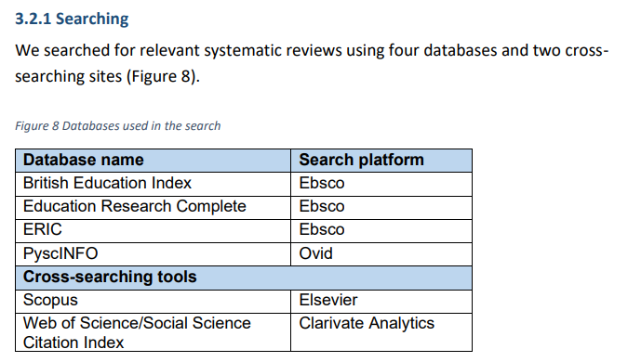

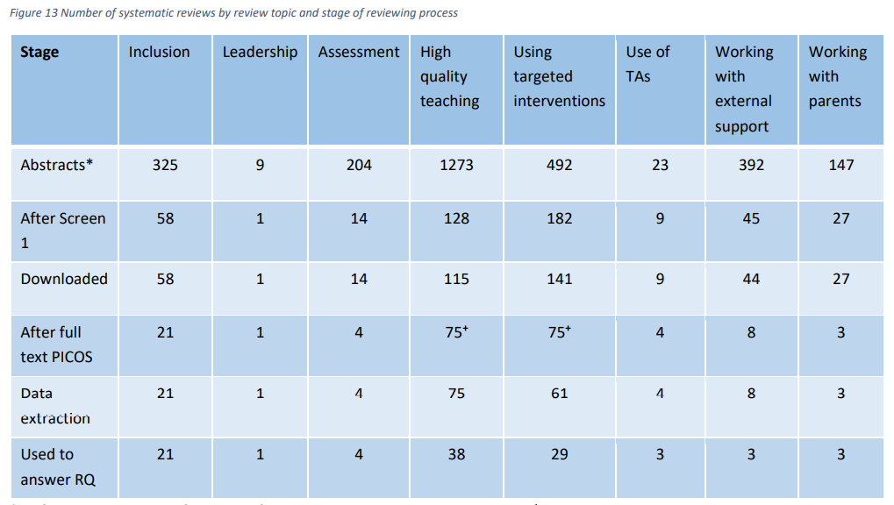
There is an evidence base…
EEF_SEND_Evidence_Review.pdf (educationendowmentfoundation.org.uk)
Notes:
GA

Slide 10
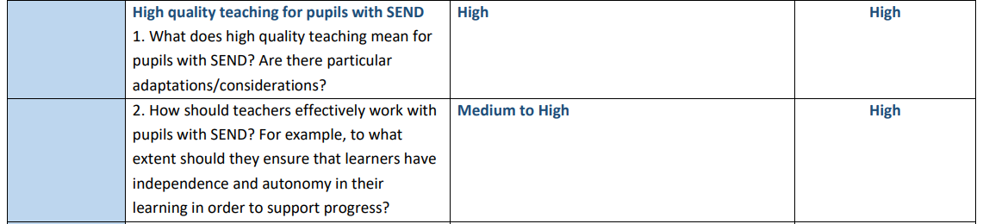
There is an evidence base…
Notes:
GA

Slide 11

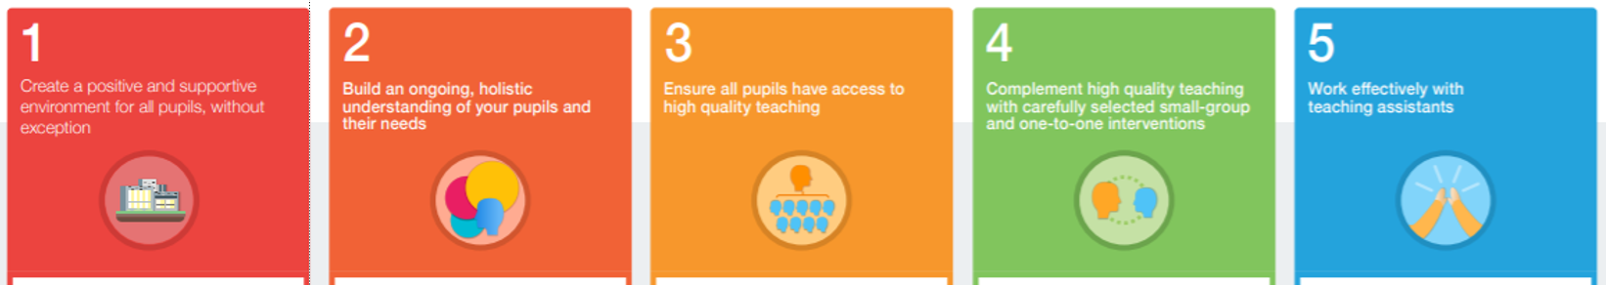
The evidence points to 5 recommendations for schools:
Notes:
Some recommendations here will be helpful to special schools although we recognise some may need to be adapted for those with profound learning needs.
The term SEND is used throughout the report to be inclusive of all pupils with these needs and in recognition of the fact that a disability will often overlap with special educational needs. However this report is about SEN and provision rather than any adaptations schools may need to make for pupils with a physical disability or long-term health condition.
The 5 recommendations that should be the focus for school improvement. The aim is to give some key ‘best bets’ for improving special educational provision. Advice here overlaps with guidance on Metacognition and Self Regulation, Improving Behaviour, Social and Emotional Learning and Working with Parents.
Note questions in chat as we go along and I will try to answer these at the end/as we go along.

Slide 12
• To a great extent, good teaching for pupils with SEND is good teaching for all.
• Searching for a ‘magic bullet’ can distract teachers from the powerful strategies they often already possess.
• The research suggests a group of teaching strategies that teachers can use flexibly in response to the needs of all pupils:
—flexible grouping;
—cognitive and metacognitive strategies;
—explicit instruction;
—using technology to support pupils with SEND; and
—scaffolding.

Slide 13
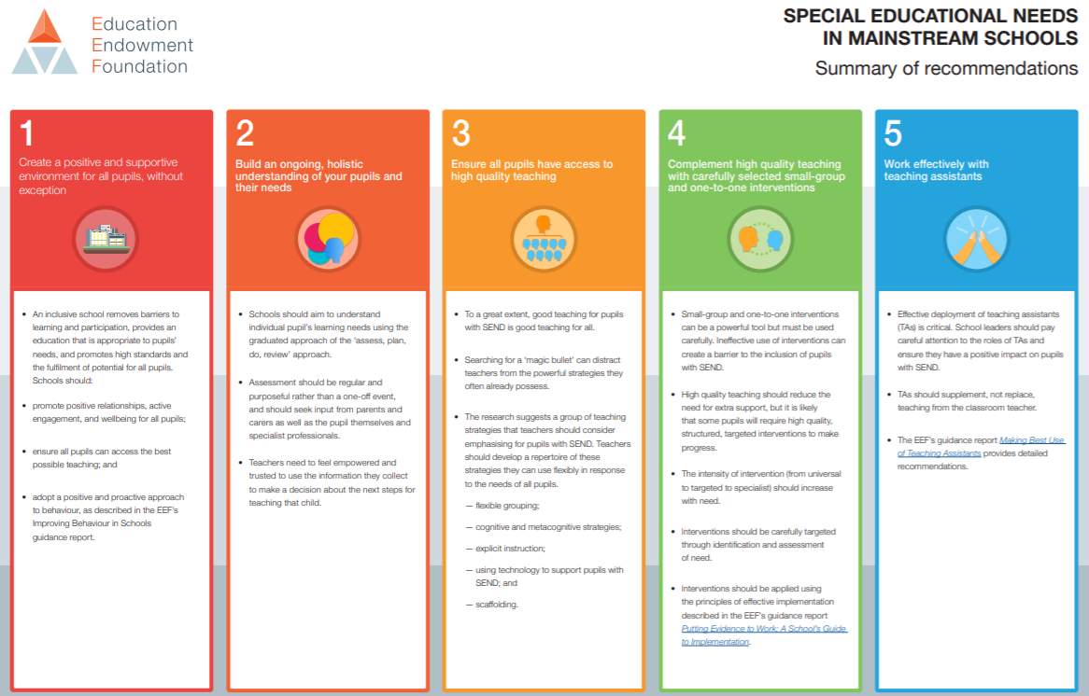
High quality teaching
Knowledge-rich curriculum
Notes:
Pupils with SEND have the greatest need for excellent teaching. It is tempting to talk about SEND as a specific and distinct issue. Yet, far from that teachers should instead prioritise familiar but powerful strategies, like scaffolding and explicit instruction to support their pupils with SEND.
The evidence review for this guidance report found strong evidence that high quality teaching for pupils with SEND is firmly based on strategies that will either already be in the repertoire of every mainstream teacher or can be relatively easily added to it. Teachers should develop a repertoire of these strategies that can be used flexibly in response to individual needs and use them as the starting point for classroom teaching for all pupils. The five strategies outlined were identified as having relatively strong evidence for their effectiveness for supporting pupils with SEND.
Although a focus on effective classroom teaching is the starting point, some pupils will require specialist support—including specific teaching methods, equipment, or curriculum—delivered by a trained professional either directly or in a consultancy role. Decisions about which specialist interventions or strategies to use will be informed by discussions with the SENCo, parents and carers, and—especially if the pupil has an EHC plan—relevant external professionals. More guidance on specialist intervention is provided in Recommendation 4.

Slide 14
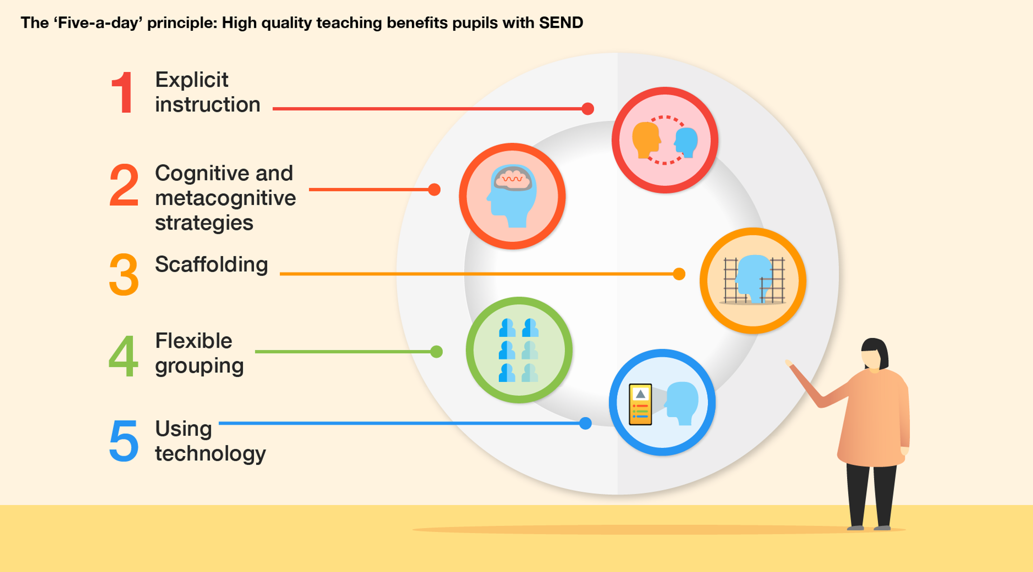

Slide 15
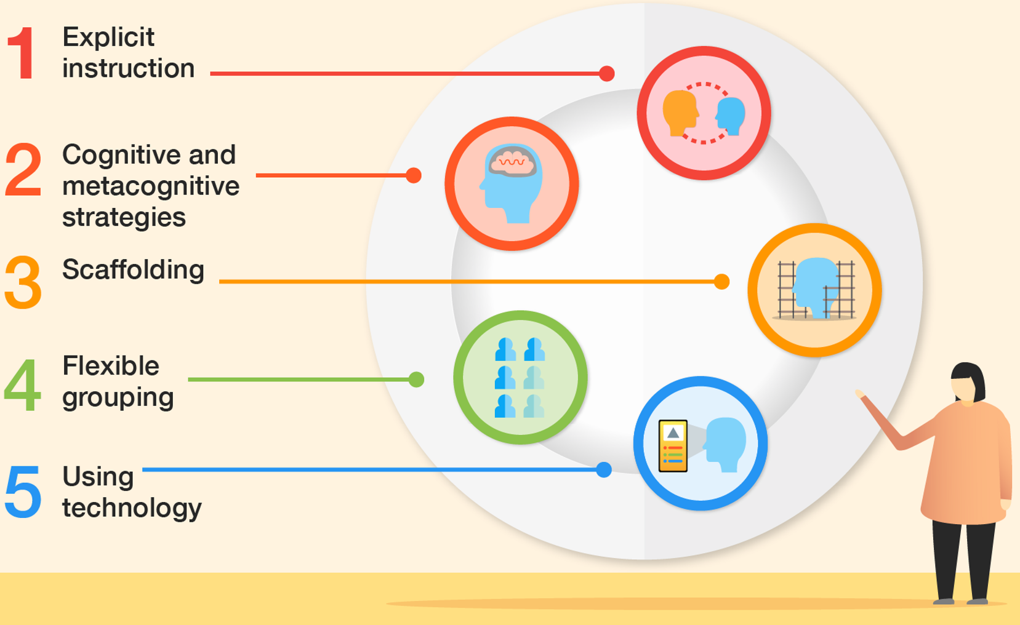
What is high-quality teaching for students with SEND?
Explicit instruction – teacher-led approaches focused on teacher demonstration followed by guided practice and independent practice.
Cognitive and metacognitive strategies – explicitly supporting students with the process of learning and with the process of thinking about learning.
Scaffolding – temporary support provided so that pupils can successfully complete tasks that they could not yet do independently.
Flexible grouping – allocating groups flexibly and responsively.
Using technology – finding ways to incorporate digital technology in how the lesson is taught and/or how students access or record their learning.
Education Endowment Foundation, ‘SEN in Mainstream Schools’ guidance report, March 2020

Slide 16



Slide 17

Explicit instruction

Slide 18
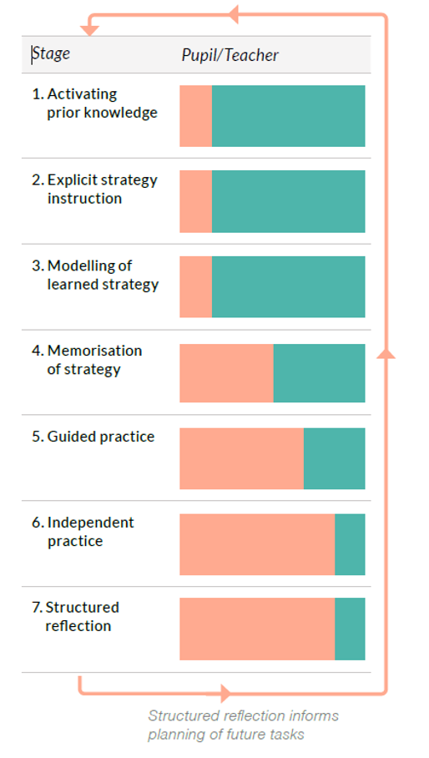
Explicit instruction

Slide 19
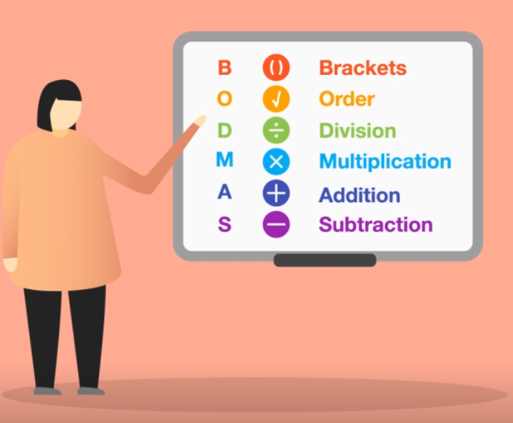
Cognitive strategies
You are about to see a list of the 11 countries in the world that have 4 letters in their name.
I will display this list for 10 seconds.
Without writing them down, how many can you remember?
Chad
Cuba
Fiji
Iran
Iraq
Laos
Mali
Niue
Oman
Peru
Togo
How did you complete that task?
Relying on prior knowledge.
Using your working memory.
Identifying a cognitive strategy (grouping them geographically, looking for patterns
It’s clear why pupils with SEND may benefit more from an explicit process of being taught cognitive strategies.

Slide 20
Metacognitive strategies
Support pupils to think metacognitively before they begin a task:
Have you done a similar task before?
What strategies have you used to solve this problem in the past?
Do you have what you need to begin the task?
Support pupils to think metacognitively during a task:
Are you making progress to meet the learning goal?
Is your chosen strategy working?
Are you finding this challenging? How are you dealing with that challenge?
Support pupils to think metacognitively after a task:
Did you accomplish your goal?
Could you do the task without support next time?
Did you stay motivated throughout the task?

Slide 21
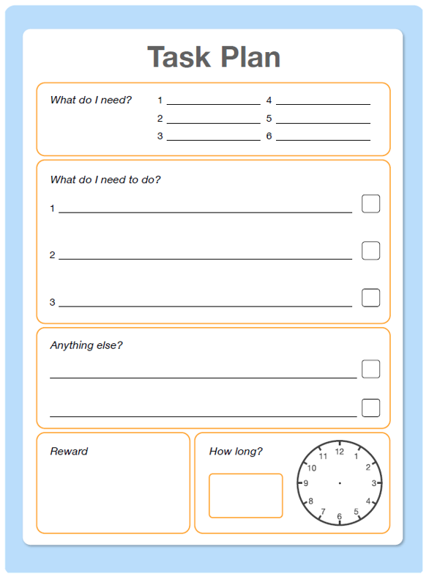



Scaffolding
Scaffolding is a metaphor for temporary support that is removed when no longer required. It may be visual, verbal or written.
Visual
Verbal
Written
Word bank
Try to use these key topic words within your answer:
Photosynthesis (the process by which plants use sunlight, water and carbon dioxide to create oxygen)
Carbon dioxide
Chlorophyll (green pigment found in plants)

Slide 22



Flexible grouping
Using technology
All pupils need support sometimes.
Intelligence is not fixed.
Responsive grouping.
A visualiser
Speech-text software
Apps that support procedural practice

Slide 23
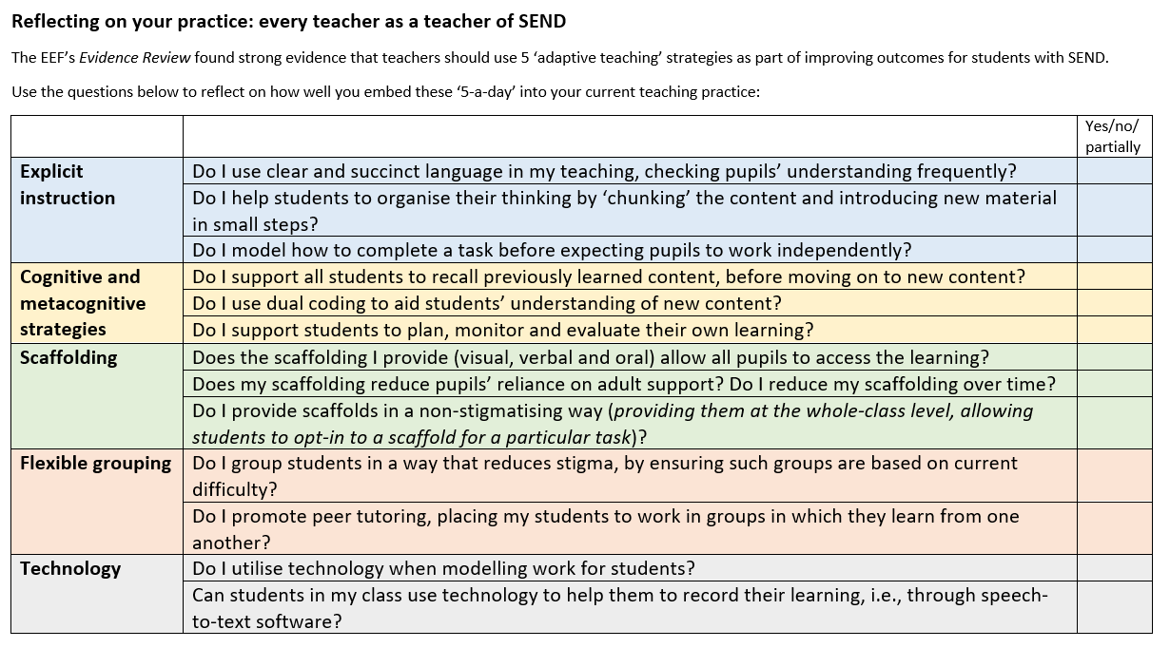

Slide 24
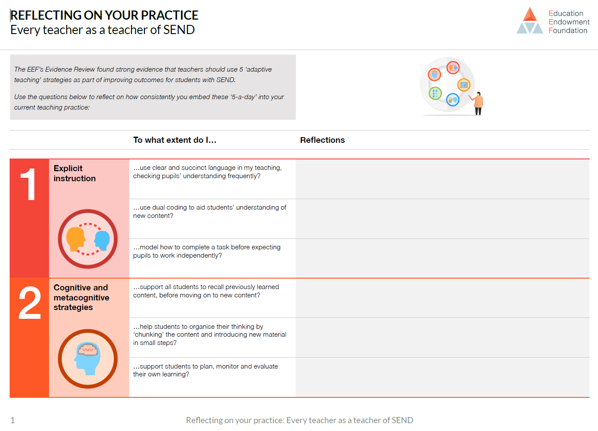
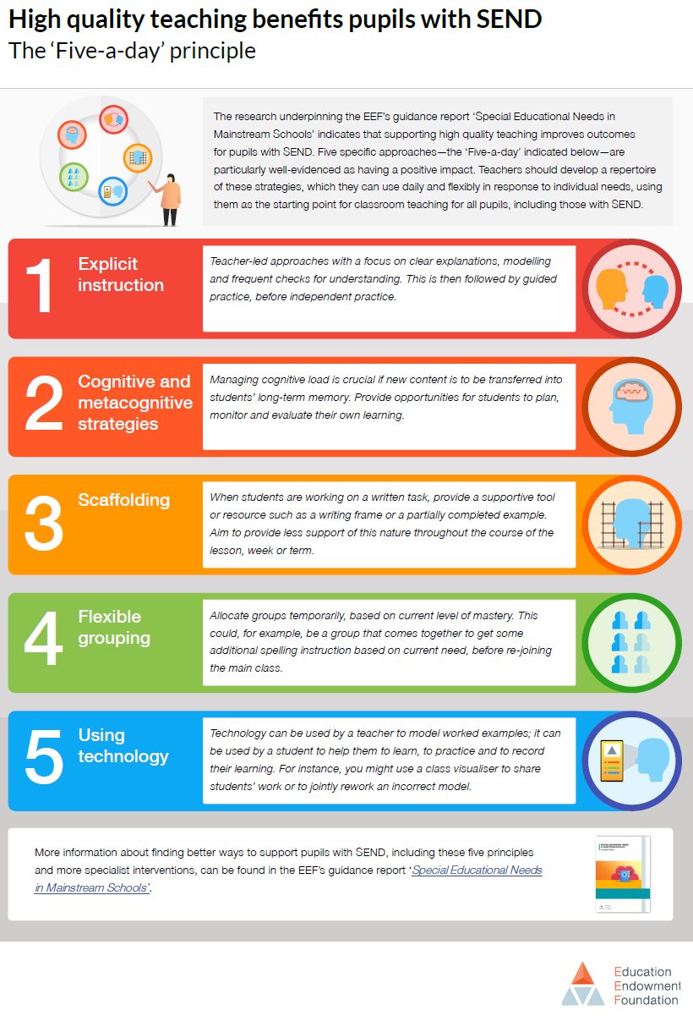
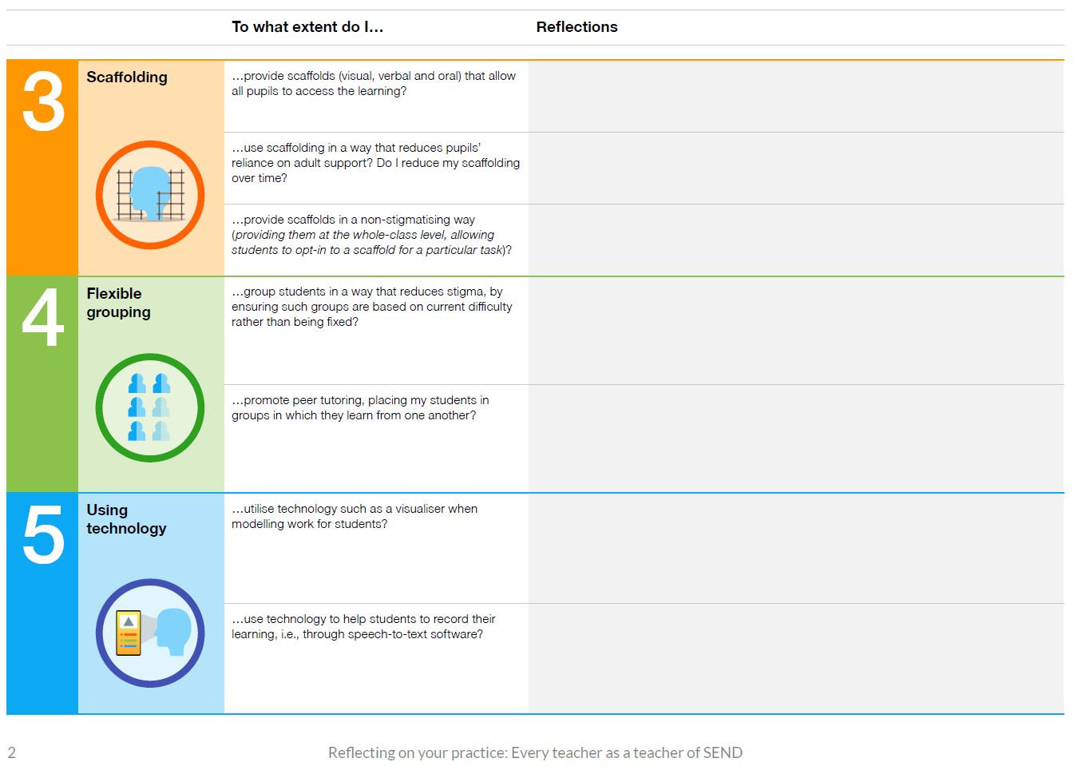

Slide 25
Reflection questions
What messages are given around SEND and teaching and learning in your school?
Are teaching assistants included in training around effective teaching and learning approaches?
Do your messages around effective teaching approaches for SEND match the evidence?
Are these five evidence-based teaching approaches well understood in your school?
EEF blog: ‘Five-a-day’ to improve SEND outcomes | EEF (educationendowmentfoundation.org.uk)
What one action can you carry out when you get back to school, relevant to this Recommendation?

Slide 26
Where do OFSTED stand on curriculum for SEND?
There is high academic/vocational/technical ambition for all pupils, and the school does not offer disadvantaged pupils or pupils with SEND a reduced curriculum.
Learners study the full curriculum
Inspectors will evaluate evidence of the impact of the curriculum, including on the most disadvantaged pupils. This includes pupils with SEND.
Disadvantaged pupils and pupils with SEND acquire the knowledge and cultural capital they need to succeed in life.
Notes:
How we achieve our mission
We summarise the best available evidence for teachers and senior leaders. Our Teaching and Learning Toolkit is now used by 70% of secondary schools.
We generate new evidence of ‘what works’ to improve teaching and learning, funding independent evaluations of high-potential projects. We’ve tested over 190 high-potential programmes with over 1.3 million children and young people and our most promising programmes have enabled students to make +3 months of additional progress in a year.
We support teachers and senior leaders across the country to use this evidence to achieve the maximum possible benefit for young people. We work in partnership with a network of Research Schools across the country.

Slide 27
What does that mean for curriculum design?
Plan a curriculum in line with the principles of cognitive science, i.e.:
i. new knowledge builds on knowledge already encountered, with explicit links made between topics.
ii. retrieval practice is a consistent part of classroom practice.
iii. cognitive load is well-managed, so that students are accessing new content in manageable ‘chunks’
2. Allow all students to access all the content, knowing that not all will learn at the same rate. Make this successful by:
i. Building in opportunities for formative assessment.
ii. In your planning, separating core content from aspirational content.
iii. Teaching in a way that supports cognitive and metacognitive processes, using explicit instruction, dual coding, worked examples, etc.
iv. Anticipating what may need to be retaught to certain students, what needs a scaffold, etc.
Notes:
Formative assessment – cold calling

Slide 28

• Small-group and one-to-one interventions can be a powerful tool but must be used carefully. Ineffective use of interventions can create a barrier to the inclusion of pupils with SEND.
• High quality teaching should reduce the need for extra support, but it is likely that some pupils will require high quality, structured, targeted interventions to make progress.
• The intensity of intervention (from universal to targeted to specialist) should increase with need.
• Interventions should be carefully targeted through identification and assessment of need.
• Interventions should be applied using the principles of effective implementation described in the EEF’s guidance on Implementation.
Implementation | EEF (educationendowmentfoundation.org.uk)

Slide 29
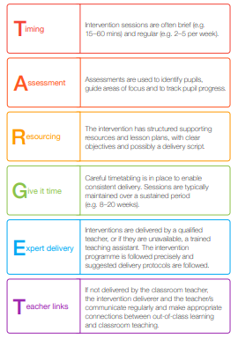
Selecting interventions

Slide 30

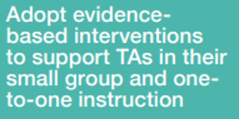
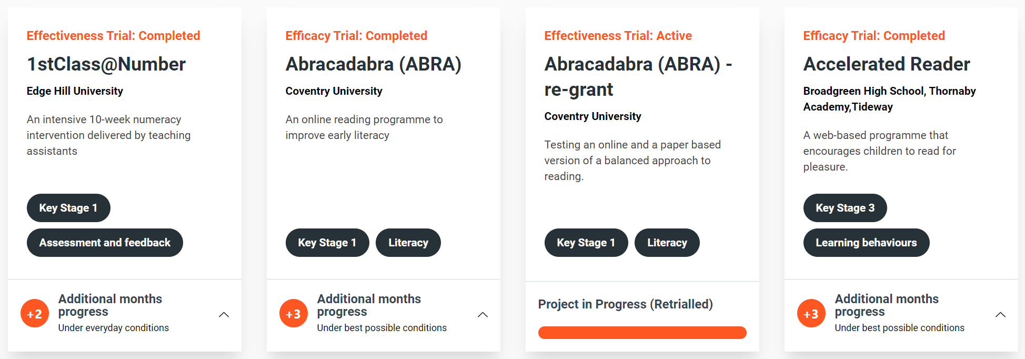
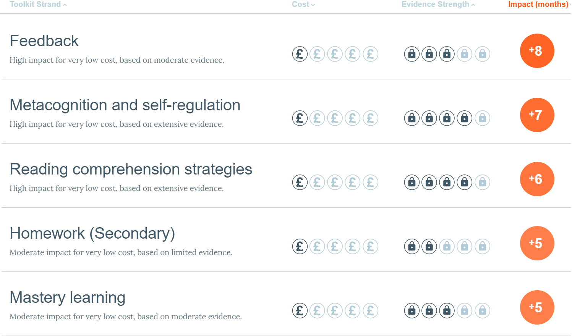
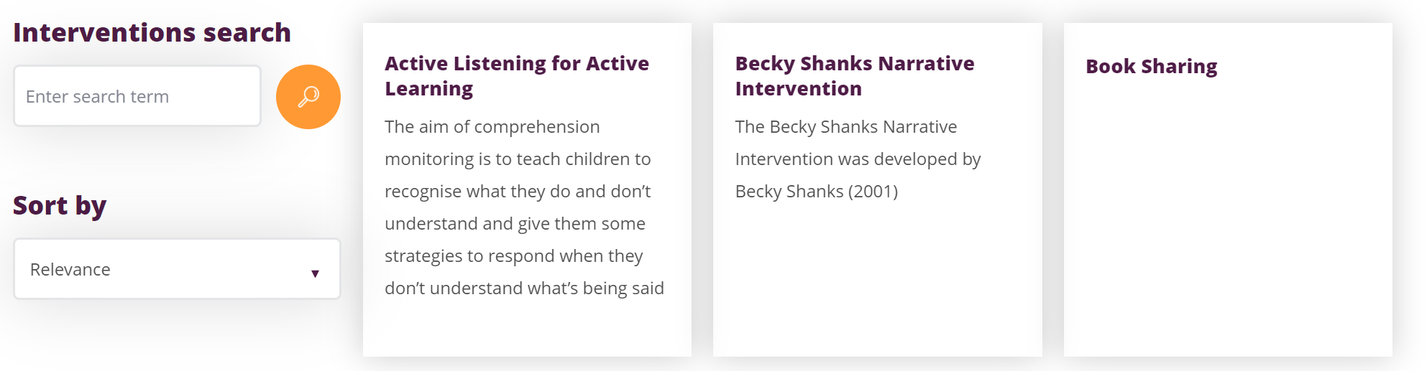
Which interventions to run

Slide 31
Reflection questions
Is TARGET enacted in your school?

Slide 32

• Effective deployment of teaching assistants (TAs) is critical. School leaders should pay careful attention to the roles of TAs and ensure they have a positive impact on pupils with SEND.
• TAs should supplement, not replace, teaching from the classroom teacher.
• The EEF’s guidance report Making Best Use of Teaching Assistants provides detailed recommendations.

Slide 33
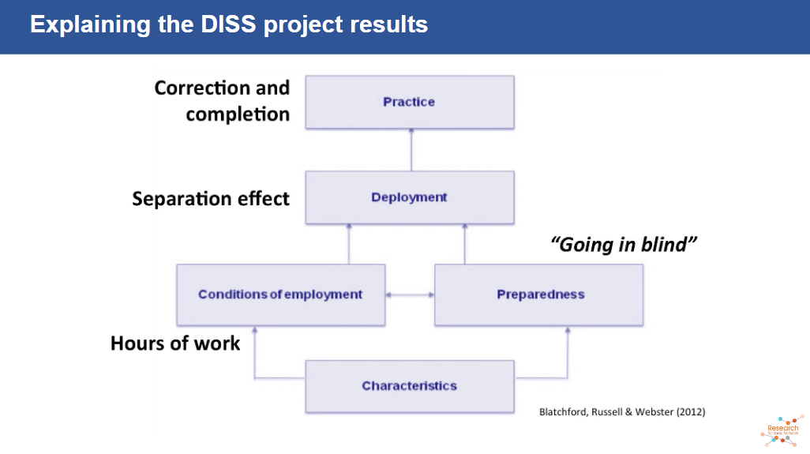

Slide 34
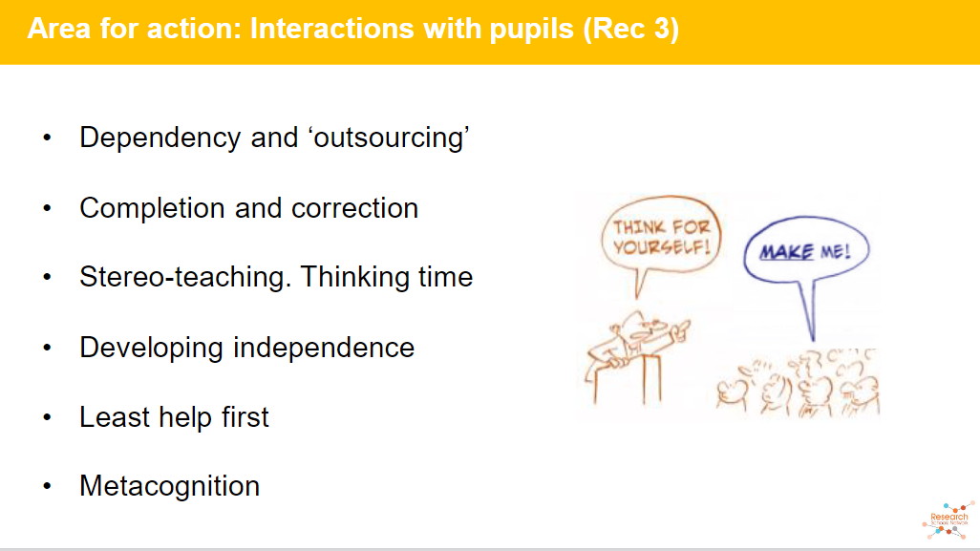

Slide 35
Reflection questions
What does this look like in your school?
Terms of employment
Evidence-informed practice
Teacher decisions

Slide 36
The problem:
Nationally, outcomes for students with SEND are poor.
The greatest lever we have to drive SEND outcomes is teaching and learning.
SENDCOs are uniquely placed to support teachers but often lack the capability or opportunity to have influence.
Our explanation of ‘high-quality teaching’ needs to be good.
Notes:
How we achieve our mission
We summarise the best available evidence for teachers and senior leaders. Our Teaching and Learning Toolkit is now used by 70% of secondary schools. REFER TO UPDATED TK
We generate new evidence of ‘what works’ to improve teaching and learning, funding independent evaluations of high-potential projects. We’ve tested over 190 high-potential programmes with over 1.3 million children and young people and our most promising programmes have enabled students to make +3 months of additional progress in a year.
We support teachers and senior leaders across the country to use this evidence to achieve the maximum possible benefit for young people. We work in partnership with a network of Research Schools across the country.

Slide 37
Thank you
Questions/clarifications?
www.educationendowmentfoundation.org.uk
Gary Aubin
EEF Content Specialist, SEND
@SENDMattersUK
Author, The Lone SENDCO

