Slide 1

School Leaders & Curriculum Conversations
30 September 2022
John Tomsett

Slide 2



Slide 3


Slide 4
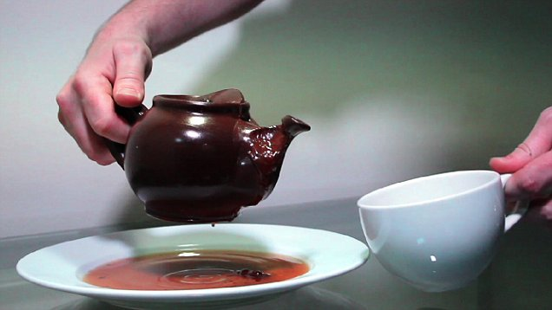
Notes:
JOHN

Slide 5

Each subject chapter…
The Subject Leader interview condensed into c.3,000 words, with a brief introduction to the history of the subject on the school curriculum;
One side of A4 overview of the KS3 curriculum;
Three documents/articles/books the senior leader should read;
Five questions you would like your senior leader line manager to ask you about the curriculum.

Slide 6
Conversation as a methodology
‘No one knows in advance what will “come out” of a conversation... A conversation has a spirit of its own, and the language in which it is conducted has a truth of its own so that it allows something to “emerge” which henceforth exists.’
(Hans-Georg Gadamer (1992), Truth and Method, trans. Joel Weinsheimer and Donald Marshall)
Notes:
MARY

Slide 7
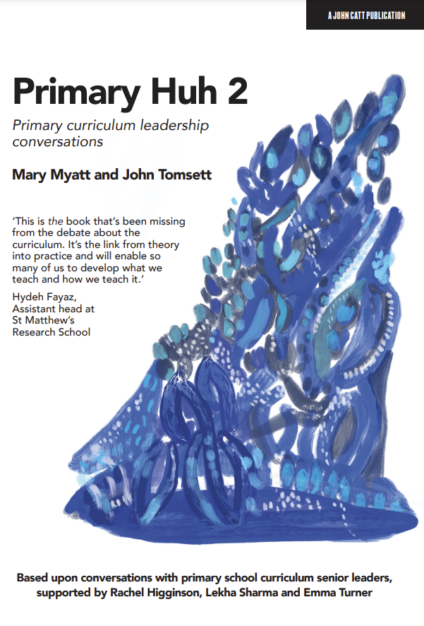


Foreword – Nick Hart
What’s the curriculum for? – Clare Sealy
Cradle to Career: the REACH curriculum – Jon Hutchinson
Building from scratch: Kents Hill’s through-school curriculum – Katy Tough
The curriculum doesn’t happen by chance: systems and structures – Kate Owbridge;
The Instil, Inspire, Innovate curriculum – Sally Newton;
The Primary Knowledge Curriculum – Alex Pethick
The 5 Rs of curriculum design – Rachel Higginson
EYFS as the foundation for all subjects – Sue Allingham;
Beyond the pastoral: curriculum transition matters – Ellie Grout;
Avoiding the cliff edge: a Years 5-8 curriculum – Rachel Sanderson and James Burrow;
Diversity in a school’s DNA – Halil Tamgumus;
Solving the curriculum conundrum of mixed age classes – Aimee Tinkler;
The philosophy and practicality of timetabling – Ben Erskine;
Problems with assessment and what to do about them – Daisy Christodoulou;
Taking colleagues with you – Mick Waters & Claire Banks.

Slide 8



Slide 9
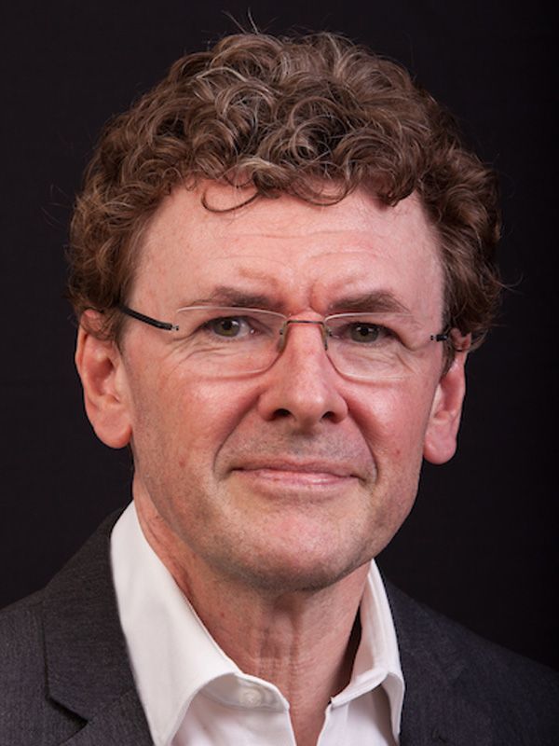
‘We must teach what is rich and meaningful and has use, from the child’s perspective.’
Barney Angliss

Slide 10
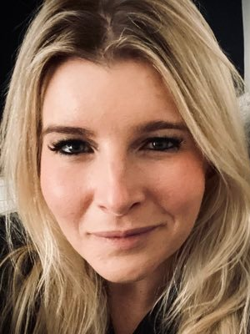
‘It’s about creating environments where children feel safe and secure and willing to take risks.’
Cassie Young

Slide 11
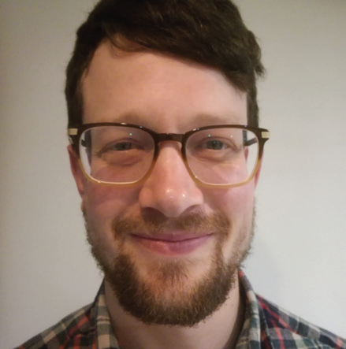
‘I would be more affirmatory and more dignified.’
Ben Newmark

Slide 12
The vocabulary of the knowledge curriculum
Substantive Knowledge
Disciplinary Knowledge
Knowledge-rich
Declarative Knowledge
Procedural Knowledge
Conditional Knowledge
Core Knowledge
Hinterland Knowledge
Threshold concepts
Notes:
JOHN

Slide 13
The curse of impenetrable terminology…
‘We shouldn’t be intimidated by some of the tremendous teachers and speakers who make us feel this language and understanding is normalised. Only a minority of existing middle leaders have the language being used commonly about curriculum theory and so it needs a steady, pragmatic approach if we are to meet middle leaders where they are.’
Notes:
JOHN

Slide 14
Fear-free terminology of the knowledge curriculum?
The “stuff” you want students to be able to know, understand and do by the time you have finished teaching them a rich, challenging, ambitious curriculum!
SUBSTANTIVE: The subject specific knowledge that you want students to know, understand and do;
PROCEDURAL: Subject specific strategies used to apply the subject’s substantive knowledge to solve a problem or complete a task.*
CONTROL: General problem solving strategies used when procedural strategies for applying substantive knowledge do not seem to work when attempting to solve a problem or complete a task (often called metacognitive strategies).
*A skill is an acquired ability to perform well, proficiency.
A strategy is a systematic plan, consciously adapted and monitored, to improve one’s performance in learning.
Notes:
JOHN

Slide 15
Term | Definition | AKA
Subject specific content knowledge and conceptual understanding | The stuff you want pupils to know, understand and do in your subject if you have successfully taught them a rich, challenging curriculum. This “stuff” is central to being able to think mathematically, or scientifically, or historically, or to communicate clearly. | Substantive knowledge Declarative knowledge
The subject specific pursuit of truth | A curricular concept for what pupils learn about how that knowledge was established, its degree of certainty & how it continues to be revised by scholars, artists or professional practice. It is that part of the subject where pupils understand each discipline as a tradition of enquiry with its own distinctive pursuit of truth. | Disciplinary knowledge
Subject specific skills/strategies | The skills/strategies specific to your subject which can either help pupils develop subject knowledge or apply subject knowledge to solve problems. | Procedural
Knowledge of Metacognitive strategies | ‘to know when and which one’ is knowledge about when to use a procedure, skill, or strategy and when not to use it; why a procedure works and under what conditions; and why one procedure is better than another. | Conditional knowledge
Core and hinterland knowledge | The core knowledge you want pupils to remember is supported by an equally important hinterland, the little examples, the stories, the illustrations, the richness, the dwelling on this but not that, and the times when you as a teacher go off-piste with your passion. | N/A
Key concept | An important concept which allows pupils to understand what comes next in a subject. | Threshold concept
Notes:
JOHN

Slide 16

“When you spend time on something – anything – that is time you cannot spend on something else.”

Slide 17
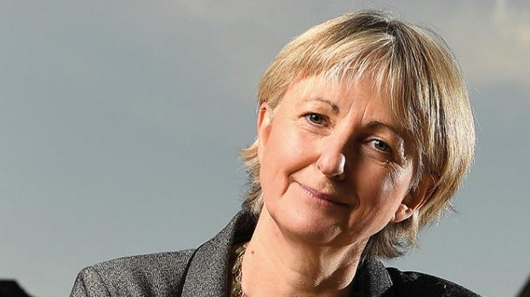
“Curriculum is content structured as narrative over time.”

Slide 18


Slide 19
SP 1: The history of the ***** curriculum at our school
How was this curriculum developed over time?
Who has been involved in this process?
Who put these different elements together?
Who wrote this and why, and when did this get introduced and why is it here instead of there?
Has it always been at this point in the curriculum? Why?

Slide 20
SP 1: The history of the ***** curriculum at our school
Which of these legacy issues are proving barriers to specific improvements we’d like to see and/or specific improvements we think we need to think about and/or specific improvements that an external subject specialist or subject resource might suggest is desirable?
Let’s kick ideas about together around how we might OVERCOME those barriers so that we get beyond these legacy issues.

Slide 21
SP 2: General overview?
Let’s begin with Year 6/9. Imagine it is the last ***** lesson in Year 9. If we have taught a rich, challenging, ambitious curriculum for all the pupils in front of us, what does success look like?
If that is where we want to end up, how do we build up to that point from EYFS/Year 7?
What are the building blocks of the curriculum from EYFS to Year 6/Years 7 to 9?
Can we explain how we decide upon which aspects of the content to use to exemplify which aspects of conceptual understanding in *****?
How rooted is the current curriculum in the National Curriculum for your subject?

Slide 22
SP 2: General overview?
Have we got a strong enough focus on diversity and anti-racist messages in our curriculum?
Do we give girls a clear sense that they can be the leaders and the decision makers and tough and resilient?
Do we give boys messages that they can be emotional and sympathetic and loving and caring?

Slide 23
SP 3: Curriculum Sequencing 1: Why that, then, to them?
Why do we teach that to those pupils, at that point in the scheme of learning?
Follow the answer to the first question with an in-depth discussion from what arises. For example, having answered that question, the subject leader asks, ‘Can we explain more about what we’ve just said? We’ve said Y follows on well from X because…. But how exactly does the knowledge/expertise achieved in the unit before/ the stories/texts/works in the previous term/year manifest itself in this new unit? How does it get practised in this new unit? How does it get questioned in this new unit? How does it get modified/extended in this new unit?’ Then we might want to consider the following questions…

Slide 24
SP 3: Curriculum Sequencing 1: Why that, then, to them?
What else could we teach to those pupils, at that point in the scheme of learning that might be richer, more challenging and more ambitious?
What else could we teach to those pupils, at that point in the scheme of learning that might better link what they have learnt before to what they are learning next?
What are the key concepts of the subject and how do we plan for when and how we teach them?
How does the content of this unit of study allow students to develop their conceptual understanding and their subject specific skills?
How have we woven formative and summative assessments through this curriculum unit to maximise pupils' learning?

Slide 25
SP 4: Curriculum Sequencing 2: Boring down into the fortnightly curriculum
What are Year 4/8 learning at the moment in their lessons?
What is that building upon from what they have learnt previously?
How will what they are learning now prepare them for what they are going to be learning over the next two weeks, month, two months and so on?
How does that key concept link to what they’re going to be studying in a few weeks’ time or a few months’ time?

Slide 26
SP 4: Curriculum Sequencing 2: Boring down into the fortnightly curriculum
So, why do we focus on this in this particular lesson or at this particular point?
What vocabulary do we think children are not going to be able to access?
How are we going to explain this particular concept?
What kind of common language are we going to use?
How are you supporting the lower/higher prior attainers?

Slide 27
SP 4a: To pupils in the classroom…
What are you learning about and why?
How does this lesson fit in with what you learnt last lesson? What do you think you might be moving on to study next?
How do you know how to improve in this subject?
To what extent do you find the work challenges you and makes you think more about the topics you are studying?

Slide 28
SP 5: Assessment and responsive pedagogy
How are we going to look at assessing pupils’ learning of your curriculum in a way that is meaningful?
How does this allow us to understand what pupils know, understand and can do at this point?
How is this the most appropriate way to assess at this point in your curriculum?
How true is this assessment to our curriculum and to our subject discipline?
How scholarly is this?
To what extent do colleagues respond in their teaching to what assessment data is telling them about what has been learnt?
How, as a department, do we decide which formative assessment method we will use and why?

Slide 29
SP 6: Misconceptions
What are the pupils’ likely misconceptions in this unit of work?
Does the rest of your department know that? How do we know?
How do we help the pupils overcome those misconceptions?
How do we prepare less experienced teachers to approach the teaching of the identified misconceptions?
How as a department do we share good practice and different teaching strategies?

Slide 30
SP 7: What is great and how can we spread the greatness?
Which part of our curriculum do we love, which part really works, which part really sings? (That could include how well it builds upon what has gone before in the curriculum’s narrative and extends/deepens pupils' subject knowledge and understanding.)
What is it about that part of your curriculum that is so wonderful?
What is it that taps into the pupils’ interest?

Slide 31
SP 7: What is great and how can we spread the greatness?
What is it that is really helping the pupils learn in that particular unit?
Which part of our curriculum do we feel we need to change? Why?
How can we make changes to these less effective parts of the curriculum in the light of what we know makes some of your curriculum really work?
Now that we have identified the less effective parts of the curriculum, how can we work as a department to develop these aspects of the curriculum?

Slide 32
And finally…
Why?
How do we know? (Where is the evidence?)

Slide 33
If you could only ask one question…
“Why do we teach that to those pupils, at that point in the scheme of learning?”
Notes:
JOHN

Slide 34
SP 1: The history of the ***** curriculum at our school
SP 2: General overview?
SP 3: Curriculum Sequencing 1: Why that, then, to them?
SP 4: Curriculum Sequencing 2: Boring down into the fortnightly curriculum
SP 5: Assessment and responsive pedagogy
SP 6: Misconceptions
SP 7: What is great and how can we spread the greatness?
Why?
How do we know? (Where is the evidence?)
“Why do we teach that to those pupils, at that point in the scheme of learning?”

Slide 35

Starting points, not the last word…
Notes:
MARY

Slide 36

In the light of what you are currently working on in your curriculum, which of the 7 starting points would most help you?

Slide 37


www.huhleaders.com
Jan-Feb 2023

Slide 38


Slide 39
School Leaders & Curriculum Conversations
29 September 2022
John Tomsett
@johntomsett
jtomsett@hotmail.com
www.johntomsett.com

